Slide 1
Entrepreneurship (MBA 7001)

Slide 2


Slide 3
Entrepreneur
The term” entrepreneur” is derived from the French verb ‘enterprenedre’. It means “to undertake”.
An entrepreneur is a person who undertakes and operates a new enterprise or venture and assumes some accountability for the inherent risks.

Slide 4
Concept of Entrepreneurship
Entrepreneurship is a process undertaken by an entrepreneur to augment his business interest. It is an exercise involving innovation and creativity that will go towards establishing his/her enterprise.
Entrepreneurship is the composite skill and the resultant of a mix of many qualities, traits and ability to bring together capital, labor, land, thus to mobilize scientific and technological advances to establish a new and innovative venture/ enterprise.

Slide 5
Functions of Entrepreneur
Idea generation and scanning of the best suitable idea
Determination of the business objectives
Product analysis and market research
Deciding the form of ownership/organization
Completion of promotional formalities
Raising necessary funds
Procuring machine and material
Recruitment of men
Undertaking the business operations

Slide 6
Intrapreneurs
They are entrepreneurs who catch hold of a new idea for a product, service, or process and work to bring this idea within the framework of the organization.
Difference between Entrepreneur and Intrapreneur
1. Dependency: An entrepreneur is independent while an Intrapreneur is dependent on the entrepreneur. i.e., owner
2. Raising of funds : An Entrepreneurs can raise fund required for the enterprise while an Intrapreneurs can not raised the funds.
3. Risk : An Entrepreneurs bears the risk involved I the business while an intrapreneurs does not fully bear the risk
4. Operations: Entrepreneurs operates business from outside while intrapreneurs operates from within the organization itself.

Slide 7
Characteristics of an Entrepreneur
An entrepreneur must be reasonably intelligent, and should have creative thinking and must be able to analyse various problems and situations in order to deal with them.
An entrepreneur should have clear objectives.
Business secrecy: An entrepreneur must be able to guard business secrets. Leakage of business secrets to trade competitors is a serious matter which should be carefully guarded against by an entrepreneur.
Human relations ability: An entrepreneur must maintain good relations with his customers if he is to establish relations that will encourage them to continue to patronize his business. He must also maintain good relations with his employees if he is to motivate them to perform their jobs at a high level of efficiency.
Communication ability: An entrepreneur who can effectively communicate with the customers, employees, suppliers and creditors will be more likely to succeed than the one who does not.
Technical knowledge: An entrepreneur must have a reasonable level of technical knowledge.

Slide 8
Classification & Types of Entrepreneurs
Based on the Type of Business
1. Trading Entrepreneur
2. Manufacturing Entrepreneur 3.Agricultural Entrepreneur
Based on the Use of Technology
1. Technical Entrepreneur 2. Non-Technical Entrepreneur
Based on Ownership
Private Entrepreneur
State Entrepreneur 3. Joint Entrepreneurs
Based on Gender
1. Men Entrepreneurs
2. Women Entrepreneurs :Women entrepreneurs are defined as the enterprises owned and controlled by a woman or women having a minimum financial interest of 51 per cent of the capital and giving at least 51 per cent of employment generated in the enterprises to women.

Slide 9
Based on the Size of Enterprise:
1. Small-Scale Entrepreneur:
An entrepreneur who has made investment in plant and machinery up to Rs 1.00 crore is called ‘small-scale entrepreneur.’
2. Medium-Scale Entrepreneur:
The entrepreneur who has made investment in plant and machinery above Rs 1.00 crore but below Rs 5.00 crore is called ‘medium-scale entrepreneur.’
3. Large-Scale entrepreneur:
The entrepreneur who has made investment in plant and machinery more than Rs 5.00 crore is called ‘large-scale entrepreneur

Slide 10
Based on Clarence Danhof (1949) entrepreneurs can be Classified in following major categories
1. Innovative Entrepreneurs
It is a type of entrepreneur, who launches new products, discovers new markets, establishes new methods of production and restructures the enterprise.
2. Imitative Entrepreneurs
They adopt victorious innovations launched by the innovative entrepreneurs. They duplicate the technology and techniques innovated by others and they are suitable for underdeveloped countries. They are characterized by readiness to adopt successful innovations, by innovative entrepreneurs. They are adoptive and more flexible.
3 . Solo Entrepreneurs
They basically work alone and if required may recruit few people.

Slide 11
4. Fabian Entrepreneurs:
They are exemplified by great caution and skepticism in experimenting any change in the organization. They imitate only in situations where it becomes necessary to do so.
5. Drone Entrepreneurs:
They suffer losses, as they refuse to make any modifications in the existing production methods. They are exhibited by refusal to adopt and use opportunities to make changes in production. Also called as ‘laggards’ because they continue in their traditional ways and in fields; their product loses its marketability soon.

Slide 12
Entrepreneurship – Barrier & Motivation
The entrepreneurial barriers are lack of qualities, family barrier, peer group barrier, locality barrier, societal barrier, political barrier, financial barrier, legal barrier, red tapism and comfort zone. This is the point where the individuals intrinsic motivational behaviours supports them and takes them stage by stage and finally to their entrepreneurial goals and these motivational behaviours are termed as entrepreneurial motivation. These behaviours are curiosity, challenge and Risk taking capasity, control, cooperation, fantasy, recognition.

Slide 13
THEORIES ON ENTREPRENEURSHIP
The common and the key element in the theories of Max Weber and Joseph Schumpeter is innovation. The innovation of Weber's entrepreneur is an outcome of 'thoroughgoing rationalizing of every aspect of his enterprise'. Whereas Schumpeter's says innovation is more creative and it is not merely limited to systematic ordering of means to an end, rather entrepreneur may bring it (creativity) about a fundamental change in technology, or may create new demands, or find a new source of supply of raw materials or adopt new organizational skills.

Slide 14
David McClelland
He introduced psychological concept called 'need for Achievement' or ‘n Achievement’ adopted by entrepreneurs. By which he means 'a desire to do well, not so much for the social recognition or prestige but for the sake of an inner feeling of personal accomplishment'.
David Ricardo :
He didn’t assign any important role to entrepreneurship for economic development of a country . According to him , “profit leads to saving of wealth, which ultimately goes to capital formation and leads to economic development”.

Slide 15
John Kunkel Says:- The behavior of the individuals may be made entrepreneurial by influencing the major factors of demand composition. Opportunity competition is decided by various factors, like labour and labour market, production methods, training opportunities, skills, etc. Similarly Labour composition is operated by various factors, like sources of livelihood, traditional approach, and aspirations of life, etc.

Slide 16
According to B.F. Hauslin
Industrial entrepreneurial development is possible only in that society, where social procedures are unstable, alternatives of employment to persons are widely available and the society which encourages personality development of enterprising persons.

Slide 17
Role of Entrepreneurship in Economic Development!
Economic development essentially means a process of upward change whereby the real per capita income of a country increases over a long period of time. Entrepreneurs contribute towards the development of society by reducing concentration of income and wealth. The role of entrepreneurship in economic development varies from economy to economy depending upon its material resources, industrial climate and the responsiveness of the political system to the entrepreneurial function. The entrepreneurs contribute more in favourable opportunity conditions than in the economies with relatively less favourable opportunity conditions.

Slide 18
Viewed from the opportunity conditions point of view, the underdeveloped regions, due to the paucity of funds, lack of skilled labour and non-existence of minimum social and economic overheads, are less conducive to the emergence particularly of innovative entrepreneurs.
Further, India which itself is an developing country aims at decentralized industrial structure to mitigate the regional imbalances in levels of economic development, small-scale entrepreneurship in such industrial structure plays an important role to achieve balanced regional development.

Slide 19
It is unequivocally believed that small-scale industries provide immediate large - scale employment, ensure a more equitable distribution of national income and also facilitate an effective resource mobilization of capital and skill which might otherwise remain unutilized.
Lastly, the establishment of Entrepreneurship Development Institutes and alike by the Indian Government during the last decades is a good testimony to her strong realisation about the premium mobile role of entrepreneurship plays in economic development of the country.

Slide 20
The important role that entrepreneurship plays in the developing economies as under:
1. Entrepreneurship promotes capital formation by mobilising the idle saving of the public.
2. It provides immediate large-scale employment. Thus, it helps reduce the unemployment problem in the country, i.e., the root of all socio-economic problems.
3. It promotes balanced regional development.
4. It helps reduce the concentration of economic power.

Slide 21
5. It stimulates the equitable redistribution of wealth, income and even political power in the interest of the country.
6. It encourages effective resource mobilisation of capital and skill which might otherwise remain unutilized and idle.
7. It also induces backward and forward linkages which stimulate the process of economic development in the country.
8. Last but no means the least, it also promotes country’s export trade i.e., an important ingredient to economic development.
Thus, it is clear that entrepreneurship serves as a catalyst of economic development.

Slide 22
Factors Affecting Entrepreneurial Growth
Economic Environment:
It comprises of capital, labor, raw material and market demand. Increase in capital investment in viable projects results in increase in profits which help in accelerating the process of capital formation. Entrepreneurship activity too gets a boost with the easy availability of funds for investment. Easy availability of right type of workers also effect entrepreneurship. Easy availability of right type of workers also effect entrepreneurship. At the same time flow of raw materials also plays important role.

Slide 23
2. Social Environment:
Strongly affect the entrepreneurial behavior, which contribute to entrepreneurial growth. The social setting in which the people grow, shapes their basic beliefs, values and norms. The social factors can be
Family Background – Joint Family can Provide Family Resources to Invest and Expand Family Business.
Friends and Relatives, Religion, Social status
3. Cultural Factor
Include concepts like laws, morals knowledge.
Values and behavior accepted within the society.
Factors Affecting Entrepreneurial Growth

Slide 24
4. Psychological Factor
It is a personality characteristics which is a major determinant of entrepreneurship development.
Average level of achievement motivation existing in a society ensures a relatively high amount of entrepreneurship in the society.
People with low achievement motivation work for money or other such incentive.
People with high achievement motivation work for status, prefer personal responsibility for decision, take moderate risk and possess interest in concrete knowledge of the result.

Slide 25
5. Attitude of Government:
Government all over the world can play a very important role in the emergence of entrepreneurship. Positive actions by the government can facilitate growth of entrepreneurship whereas negative actions can adversely influence entrepreneurial emergence & growth. It is the govt. which regulates business activities.
Government should maintain a proper distribution of economic power between private and public sector.
They Encourage the tempo of industrialization by spreading entrepreneurship to every city, town or village.

Slide 26
6. Education and Technical Know How
Education, entrepreneurship and development are interrelated. Education helps in the development of capabilities of individuals which facilitates the emergence and growth of entrepreneurship
In the modern competitive world to survive the entrepreneurs have to keep an eye over the technological advances taking place around. These technological development provide opportunities for the entrepreneurs to develop and produce new product.

Slide 27
7. Financial Assistance from Institutional Sources
Liberal financial assistance from institution certainly boosts moral of young entrepreneurs.
The government grant finance to the entrepreneur on concessional basis at the low rate of interest
Various types of subsidies, concessions and facilities are given to attract entrepreneurs in backward area.

Slide 28
Project Management
A project simply means an investment opportunity exploited for profit. It is an idea or a plan which is intended to be carried out or a finite task to be completed. The World Bank defines a project as “ a plan that get an approval for a capital investment which develops & facilities to provide goods and services.”
Project Management is the process of planning, organising, monitoring and controlling all aspects of a project and motivating all involved to achieve project objectives of safety and completion within a defined time, cost and performance.

Slide 29
Phases of Project Management
Project identification: It refers to identification of business/investment opportunities. It involves scanning of the environment to find out investment opportunities.
Project formulation: It is the transformation of the idea into concrete project with scrutiny of its important preliminary aspects.
Project appraisal: It involves searching, scrutiny, analysis and evaluation of market, technical, financial and economic variables. It examines the viability of the project.
Project selection: It is the process of choosing a project rationally in the light of objectives and inherent constraints on the basis of appraisal.

Slide 30
Project implementation: It is the stage of birth of an enterprise. At the end of this stage, the idea becomes a reality.
Project follow-up and evaluation: It is the process of assessing the performance of the project after it started functioning. Project evaluation simply means assessing the progress of the project.

Slide 31
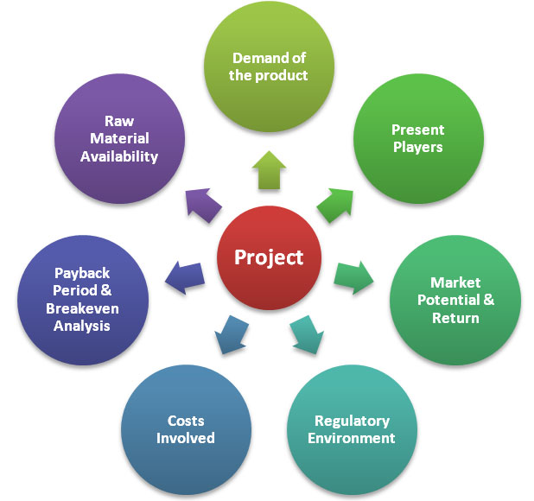
Project Identification

Slide 32
Project Formulation
It is the process of examining technical, economic, financial and commercial aspects of a project. It is the process and steps through which an opportunity becomes a project in which the entrepreneur is willing to invest his time, money and other resources.
The following are the major problems that the entrepreneur can face during project formulation phase: • Knowledge about government regulations• Absence of external economies.• Non-availability of technically qualified personnel. • Resource mobilisation • Selection of appropriate technology because modern technologies developed in the advanced countries may not be suitable for adopting in the developing countries.

Slide 33
CLASSIFICATION OF PROJECTS
Quantifiable Projects
Quantitative assessment of benefits can be made. concerned with industrial development, power generation, and mineral development.
Non- Quantifiable Projects
Where quantitative assessment is not possible. concerned with health, education, defense etc.
Sectorial Projects
Agriculture, Irrigation And Power Sector,
Industry And Mining Sector, Transport And Communication, Social Service Sector
Manufacturing, Food Processing, Health care sector etc.

Slide 34
Financial Institution Classification
All India and state financial institutions classify projects according to their age, experience and the purpose:
New projects, Expansion projects, Modernization projects and Diversification projects.
Services Projects
Welfare Projects
Research And Development Projects
Educational Projects

Slide 35
Project design and network analysis
A project comprises certain sequential activities which are interrelated. These activities can be shown in the form of a diagram, which is called network diagram. Project design is concerned with the development of a detailed work plan of the project and its time estimates.
While Network is a combination of activities and events of a project. Network analysis is one of the most popular techniques used for planning, scheduling, monitoring and co-coordinating large and complex projects comprising a number of activities.

Slide 36
Thus network is designed, its analysis is carried out to identify the optimal course of action so as to complete the project with the minimum of time and cost, subject to the available resources. Important network analysis techniques are PERT (Programme Evaluation Review Technique) and CPM (Critical Path Method).
Steps in Network Analysis
Preparation of network
Estimation of time to perform each activity
Computation of critical path schedule
Interpretation of results

Slide 37
Terms Related to Network Analysis
Network: Network refers to series of related activities .
Network diagram: It shows the activities and events of a project in a logical sequence. It is also known as project graph or arrow diagram.
Activity: It means the element of job or task or item of work to be completed in a specific time. Activity consumes • time, money, effort and resources. Each activity is represented by an arrow.
Event: It represents the start or end of an activity. An event is generally represented by a circle called node. • Each activity has 2 events- tail event and head event. Tail event is the beginning of an activity. Head event is the end of an activity.

Slide 38
Critical Path Method (CPM)
After preparing the network diagram and indicating the time for each activity, we can identify the various possible paths.
The various terms related to CPM are defined below:
Path:It refers to unbroken or continuous chain of activities from the start event to end event in the network diagram.
Critical path: It is the path which takes longest duration. It is represented by double or thick arrow line to distinguish it from the other non-critical paths.
Critical activities: These are activities lying in the critical path and its delay in start will cause a further delay in the completion of the entire project.
Preceding activities: Activities that must be completed immediately prior to the start of another activity are called predecessor activities.

Slide 39
Succeeding activities: Activities that cannot be started until one or more of other activities are completed, but immediately succeed are called successor activities.
Concurrent activities: Activities which can be accomplished concurrently or simultaneously are known as concurrent activities.

Slide 40
Steps in CPM
Arrange all activities in a logical sequence .
Construct arrow diagram and number all the events .
Mark activity times on arrows.
Calculate earliest and latest starting/finishing times and mark these times on arrow diagram.
Identify critical path.

Slide 41
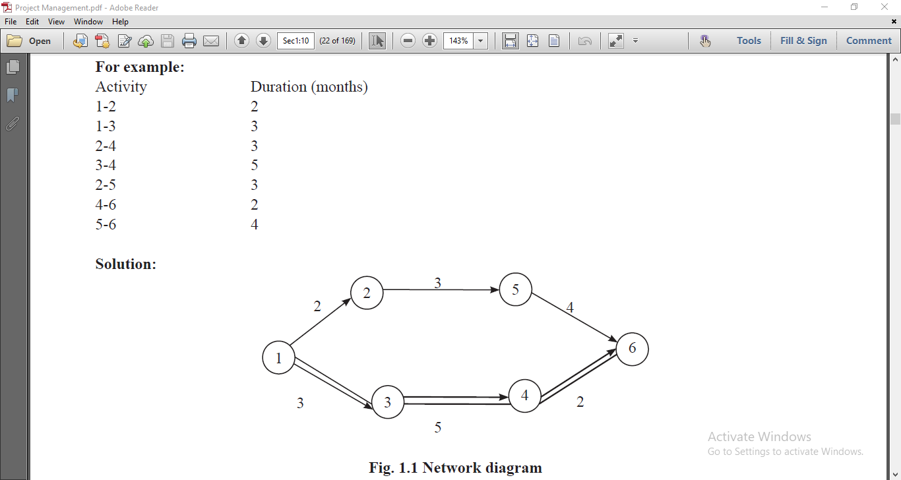

Slide 42
The following are the advantages of CPM
It makes better and detailed planning possible.
It helps in ascertaining the time schedule.
Control by management becomes easy.
It identifies most critical elements and thus more attention can be paid on these activities.
It facilitates optimum utilisation of resources.

Slide 43
The following are the limitations of CPM:
It is based on the assumption of precise known time for each of these activities.
It ignores statistical analysis in determining the time estimates.
It facilitates solution for the problem

Slide 44
Programme Evaluation Review Technique (PERT)
PERT is a network technique of scheduling and controlling the project where activity times cannot be precisely estimated. Its primary purpose is to facilitate the planning and controlling of a project in order to achieve lower costs, reduce project time and more effective co-ordination and utilisation of human and physical resources. PERT deals with the problems of uncertain activity time schedule.

Slide 45
Generally 3 time estimates that are used are:
Optimistic time (to): It is the shortest possible time in which an activity can be completed. The probability of happening this is 1 in 100.
Pessimistic time (tp): It is the maximum possible time in which an activity can be completed, if everything goes wrong. The happening this also might be 1 in 100.
Most Likely time (tm): This lies in between ‘to’ and ‘tp’. It is the estimated time in the normal conditions that an activity would require.
The expected time of each activity would be calculated by the following formula:
te = to +4tm +tp /6

Slide 46
Steps in PERT
The following steps are used in PERT:
Activities are arranged in a logical sequence.
Network diagram is drawn and events are numbered.
Using 3 time estimates, the expected time for each activity is calculated.
Slack is calculated and critical path is identified. (Slack is the maximum time an activity can be delayed without delaying the completion of project).
The total project duration is worked out.
Standard deviation and variance for each activity are found.

Slide 47
Applications of PERT
In managing accounts and budgeting of the organization.
In administration such as planning manpower profile or paper work of the organization.
In maintenance and major repairs of ships, rockets, steel furnaces, scheduling aircrafts, etc.
In installing and recognizing new systems such as plant, machinery, computers, etc.
Research and development projects.
Defence projects.

Slide 48
PROJECT REPORT: Project report or business plan is a well planned written statement of what an entrepreneur proposes to take up. It is a kind of course of action what the entrepreneur hopes to achieve in his business and how he is going to achieve it. In other words, project report serves like a road map to reach the destination determined by the entrepreneur.
Contents of Project Report: • General Information • Promoter • Location • Land and Building • Plant and Machinery • Production process • Utilities • Transport and communication • Raw material • Manpower • Product • Market

Slide 49
PROJECT APPRAISAL
Project appraisal means the assessment of a project. Project appraisal is a cost and benefits analysis of different aspects of proposed project with an objective to adjudge its viability.
A project involves employment of scarce resources. An entrepreneur needs to appraise various alternative projects before allocating the scarce resources for the best project.
Thus project appraisal helps to select the best project among available alternative projects. For appraising a projects its economic, financial, technical market, managerial and social aspect are analysed.

Slide 50
Method of Project Appraisal
1 Economic analysis (Requirements for raw material, Level of capacity utilization, Anticipated sales, Anticipated expenses, Proposed profits , Estimated demand)
2 Financial analysis (Cost of capital, Estimates of sales and production, Cost of production, Working capital requirement and its financing, Estimates of working results, Break-even point, Projected cash flow)
3 Market analysis
4 Technical analysis
5 Managerial competence
6 Ecological analysis

